Slide 1
CPUC Oversight of Utility Wildfire Spending
March 5, 2025

Slide 2
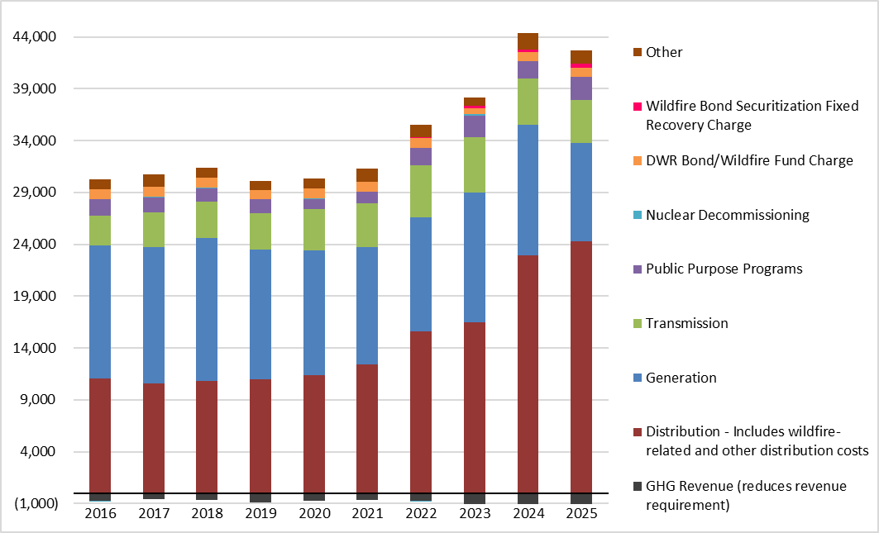
Utility Operating Costs
Trends in Electric Revenue Requirement ($ millions)
PG&E, SCE, and SDG&E
January 1, 2016 – January 1, 2025
Revenue Requirements

Slide 3
Recent Milestones in Utility Wildfire Oversight
2014
2017
2018
2019
2022
2025
CPUC starts requiring utilities to incorporate risk analysis in their proposed spending plans
Legislature enacts new utility wildfire framework (SB 901, AB 1054, AB 111)
SB 884 adds expedited pathway for powerline undergrounding
Numerous catastrophic wildfires in Southern California
Accelerated utility spending on wildfire mitigation

Slide 4
Current Utility Wildfire Oversight Framework
Wildfire Mitigation Plans (WMPs)
Development and implementation overseen by new Office of Energy Infrastructure Safety (independent of CPUC since 2021)
Cost Approval and Enforcement
CPUC oversees costs and enforcement activities
Wildfire Fund
Administered by California Earthquake Authority

Slide 5
* 2024 wildfire-related revenue requirements are still being finalized

Slide 6
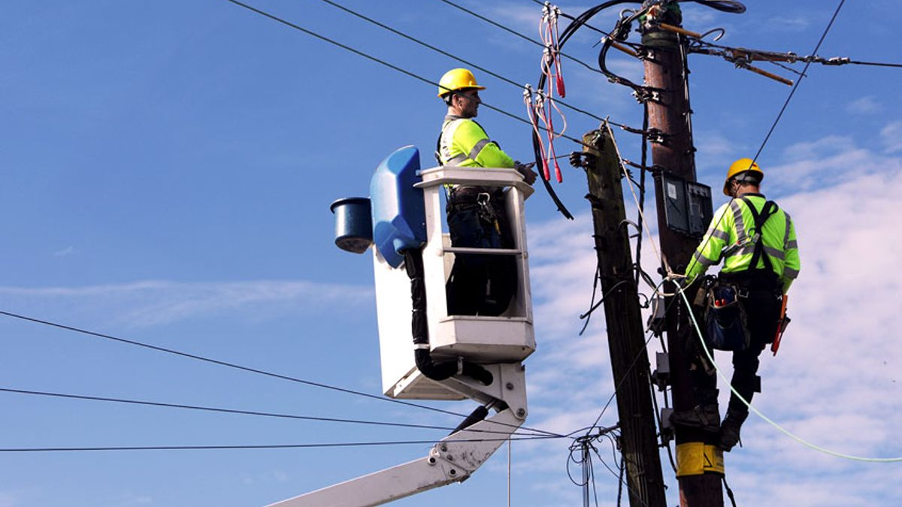
Major Categories of Wildfire Mitigation Work
Situational Awareness:
Cameras, sensors, meteorologists
Grid Design and Hardening:
Powerline undergrounding, covered conductor
Operational Mitigations:
Public Safety Power Shutoffs, “fast trip” settings
Vegetation Management:
Trimming, removal
Asset Management:
Databases, maintenance work
Community outreach:
Working groups, resources

Slide 7
Wildfire Cost Reduction Strategies
IMPLEMENTED SUCCESSFULLY
POTENTIAL NEW STRATEGIES
Align wildfire spending with CPUC review of general rate cases
Securitization of Wildfire Costs
Wildfire Self Insurance
Identify and secure external funding sources

