Slide 1
Utility wildfire risk mitigation
Duncan Callaway, UC Berkeley
OVERSIGHT HEARING, Utilities and Energy Committee
Energy Affordability: Wildfire Spending
March 5, 2025

Slide 2
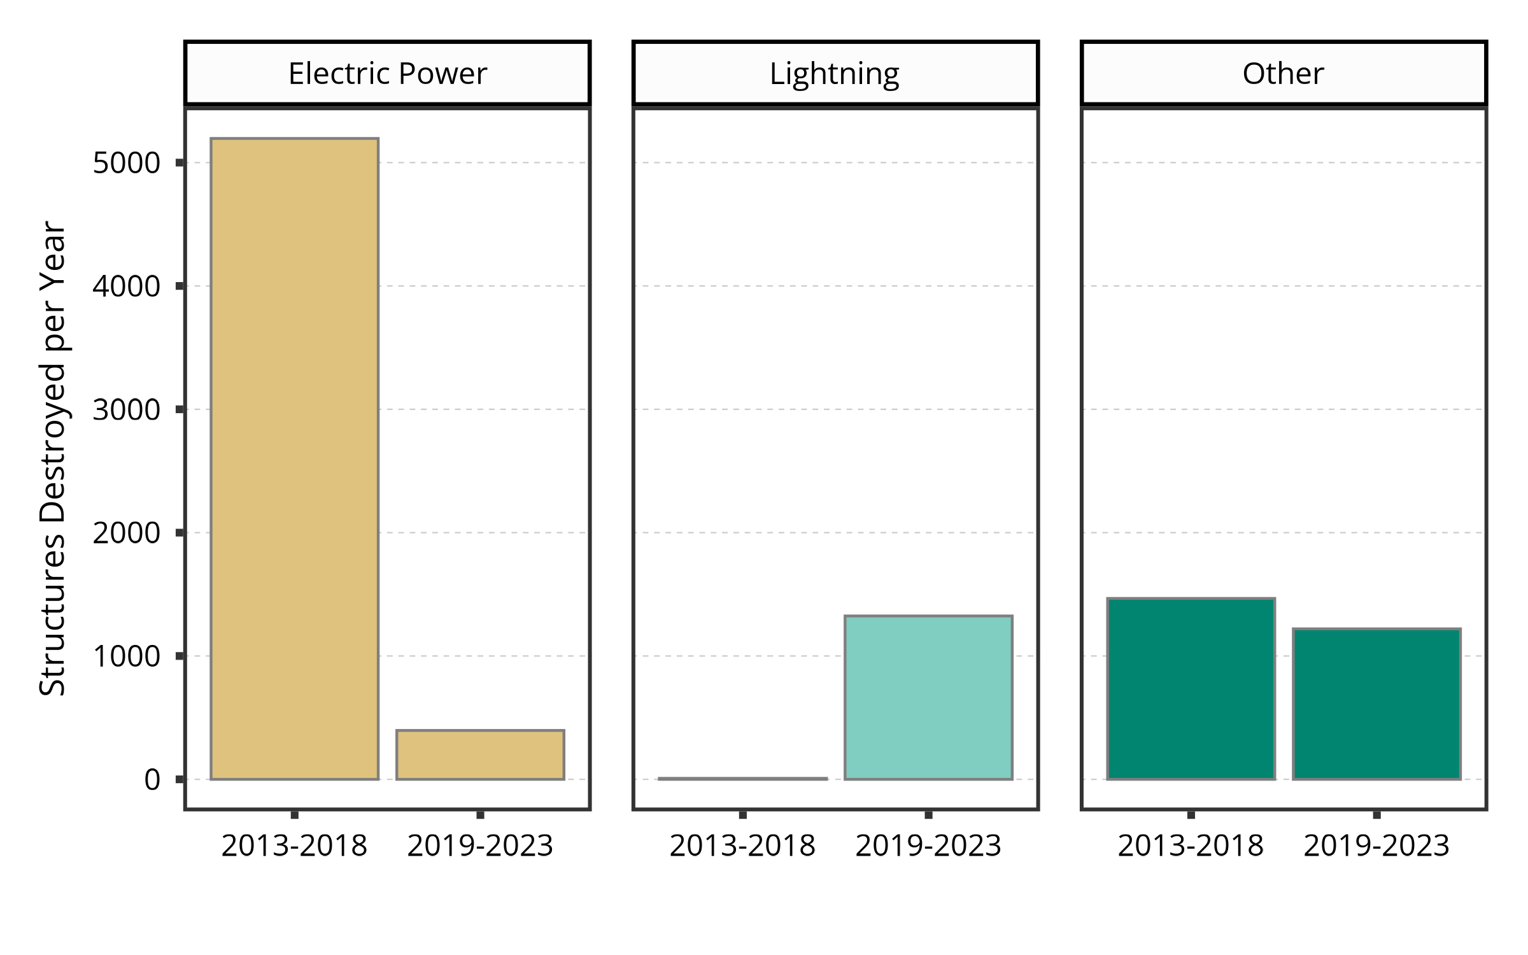
Massive ignition reductions in electric power sector
Ignition reduction from electric power sector in recent years has been enormous
Weather plays a role, but innovation and implementation does as well
Our research aims to disentangle these factors and identify what is working well and what isn’t

Slide 3
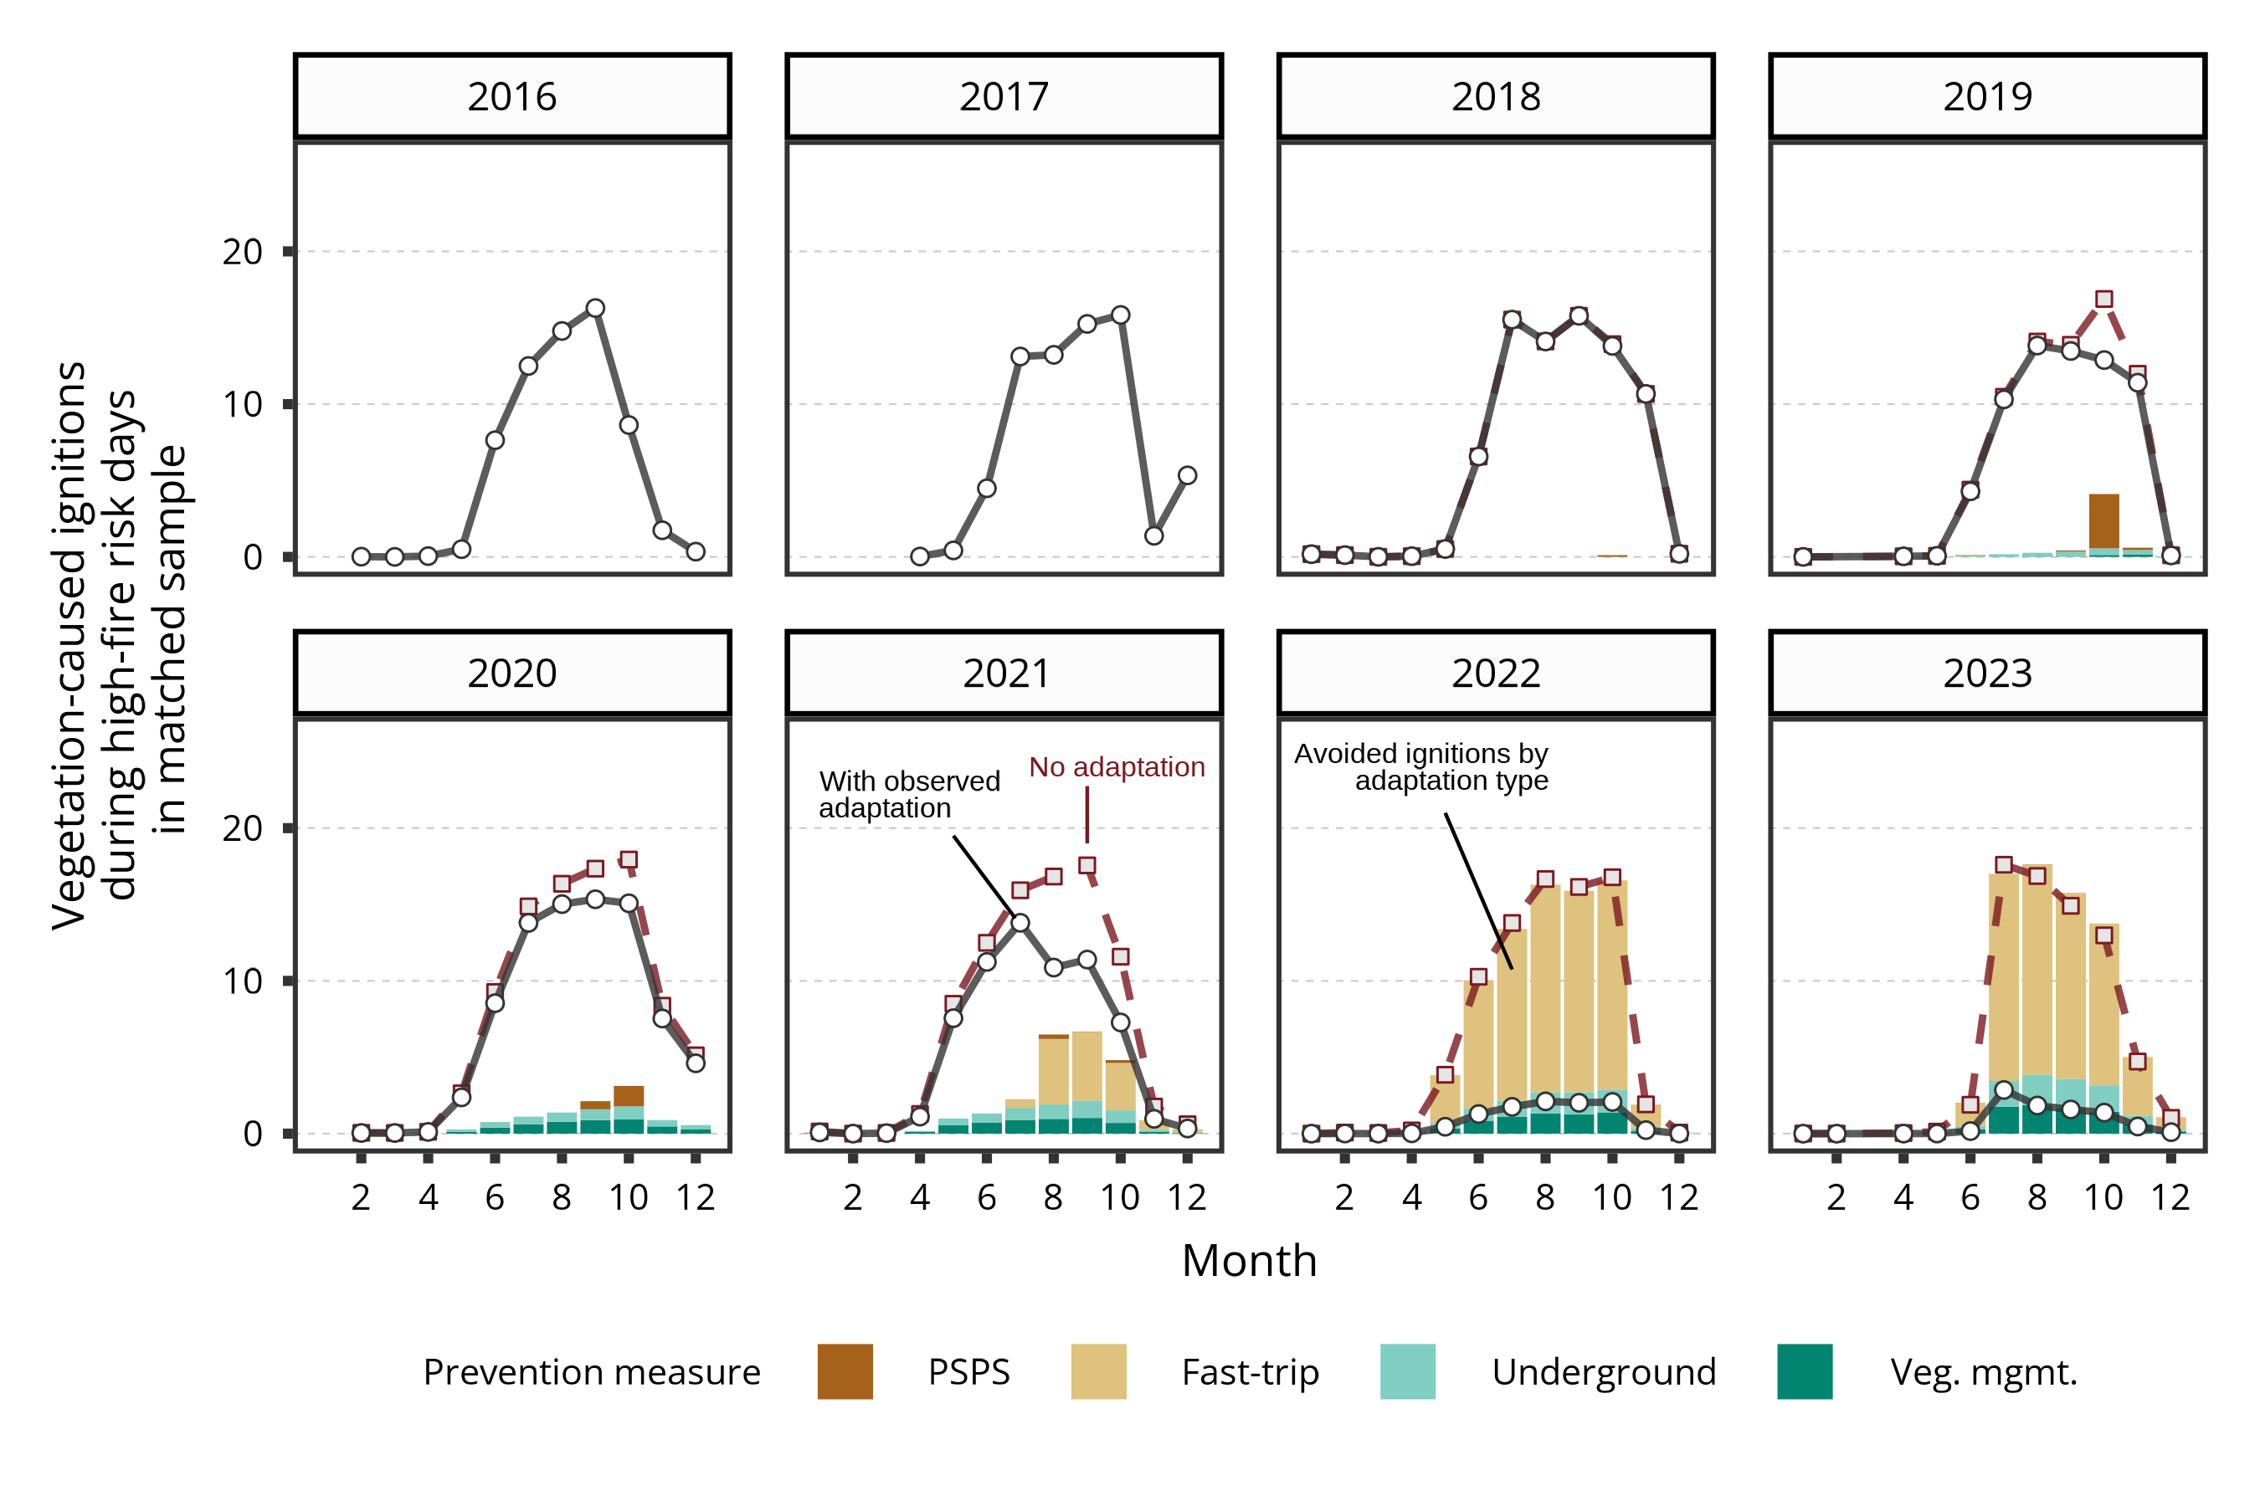
After adjusting for weather, reductions in PG&E are driven by “fast trip” settings
Our results indicate that the huge majority of PG&E’s ignition risk reduction is attributable to “enhanced powerline safety settings” (fast trip)
Fast trip was piloted in 2021 and deployed on all HFTD circuits in 2022
Fast trip settings reduce ignitions by 80%
Insufficient data to evaluate covered conductor

Slide 4
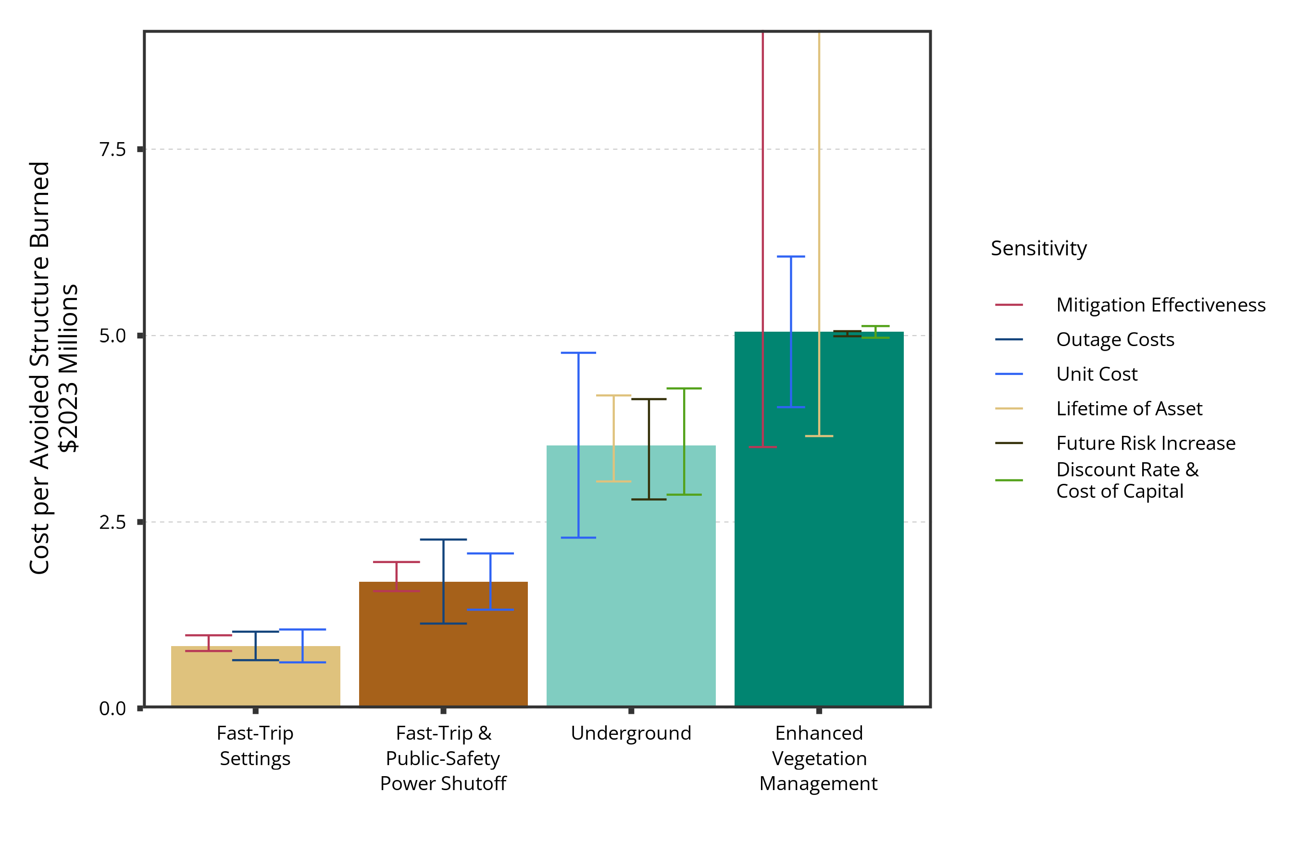
Fast trip is cost effective, but undergrounding eliminates risk on treated circuits
Our results indicate that enhanced vegetation management is less effective and more expensive than alternatives
We also find that fast trip settings are far more cost effective than the alternatives
However, relative to undergrounding, fast trip settings leave about 20% of ignition risk unmitigated

Slide 5
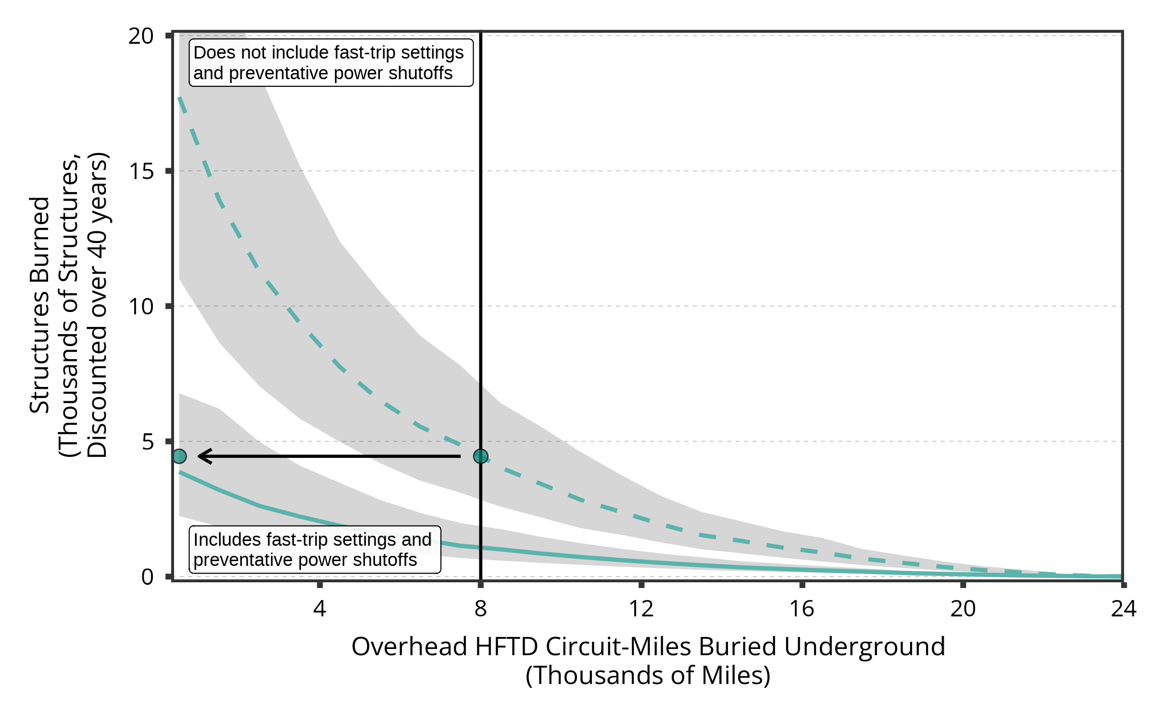
Fast trip completely changed the calculus for undergrounding
The ignition reduction benefits achieved by fast trip are equivalent to the ignition reduction benefits from undergrounding 10,000 miles (equivalent to 8,000 overhead) prior to deploying fast trip

Slide 6
Action
Third parties, CPUC need to be enabled to continuously evaluate risk mitigation actions
Utilities have many incentives that favor complete elimination of risk, including inverse condemnation and rate of return regulation
More covered conductor needed to rigorously evaluate performance
Enable innovation, avoid over-committing to expensive options now
Example: Continually revisit the appropriate level of undergrounding to achieve a given level of risk reduction
Develop systems that communicate and grapple with highly uncertain risk-benefit decisions
Climate adaptation is hard!
We need to carefully define what an acceptable level of risk is.

