Slide 1
California State Assembly
Committee on Utilities and Energy
March 26, 2025

Slide 2
RETA Beginnings
The Renewable Energy Transmission Authority Act was passed by the New Mexico legislature and signed by Gov. Bill Richardson in 2007 to plan, finance, develop and acquire high voltage transmission lines and storage projects to promote economic development in New Mexico.
RETA is a “public body, separate and apart from the state, constituting a governmental instrumentality for the performance of essential public functions.”
There are 6 voting members on the RETA Board:
3 appointed by the Governor
1 appointed by the Speaker of the House
1 appointed by the President Pro-tem of the Senate
State Treasurer or designee
Secretary of the Energy, Minerals and Natural Resources Department serves as a non-voting ex-officio member
1

Slide 3
Why has RETA been so successful?
RETA’s Benefits for Developers are Critical
Tax incentives
Gross receipts tax and compensating tax deduction
Property tax exemption
Assistance with permitting and siting
Government-level relationships with State Land Office, Department of Transportation, Middle Rio Grande Conservancy District, other state and local agencies
Streamline permitting, but not skirting environmental requirements
Powers of eminent domain
Bond financing
Available for developers needing financing support (not often used)
Reduced regulatory burden
2
2

Slide 4
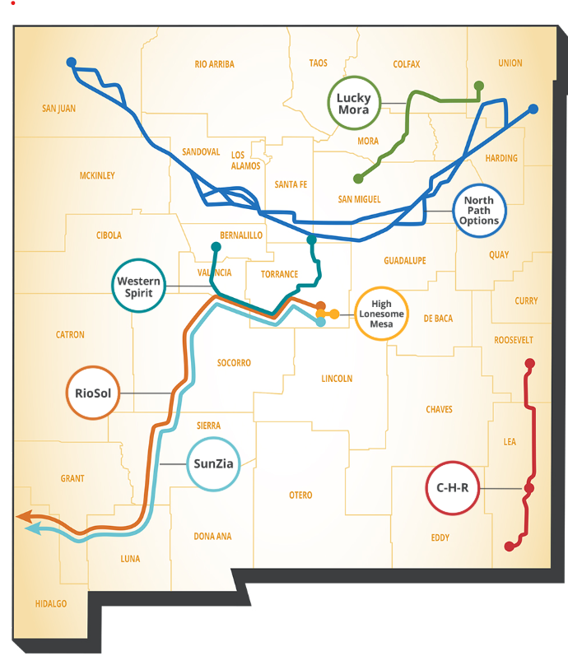
RETA’s Transmission Projects:
3
3

Slide 5
One Project Completed, One Under Construction, Four More in Development, Two Under MOU
High Lonesome Mesa – $50 million bond financing (all debt and interest paid by private developer)
32 miles, 115 kV AC, transmission upgrade, 2010 Commercial Operation Date
Western Spirit (Pattern Energy) – Sold to Public Service Company of New Mexico (PNM)
150 miles, 345 kV AC, 800 MW capacity, 2021 Commercial Operation Date
SunZia (Pattern Energy) – Under construction, central NM to south central AZ
550 miles, 525 kV HVDC – 3,000 MW capacity, 2026 estimated completion date
RioSol (SouthWestern Power Group) – In development, parallel to SunZia
550 miles, 500 kV AC – 1,500 MW, 2028 estimated completion date
North Path (Invenergy Transmission) – In development, northeast to northwest New Mexico
400 miles, 525 kV HVDC – 4,000 MW, 2032 estimated completion date
Mora Line (Ameren Transmission) – In development, northeast New Mexico
116 miles, 345 kV AC and 115 kV AC, 182 MW, 2026 estimated completion date
Crossroads/Hobbs/Roadrunner (NextEra Energy Transmission) – In development, southeast New Mexico
140 miles, double circuit 345 kV AC, 1,500 MW, 2026 estimated completion date
4
4

Slide 6
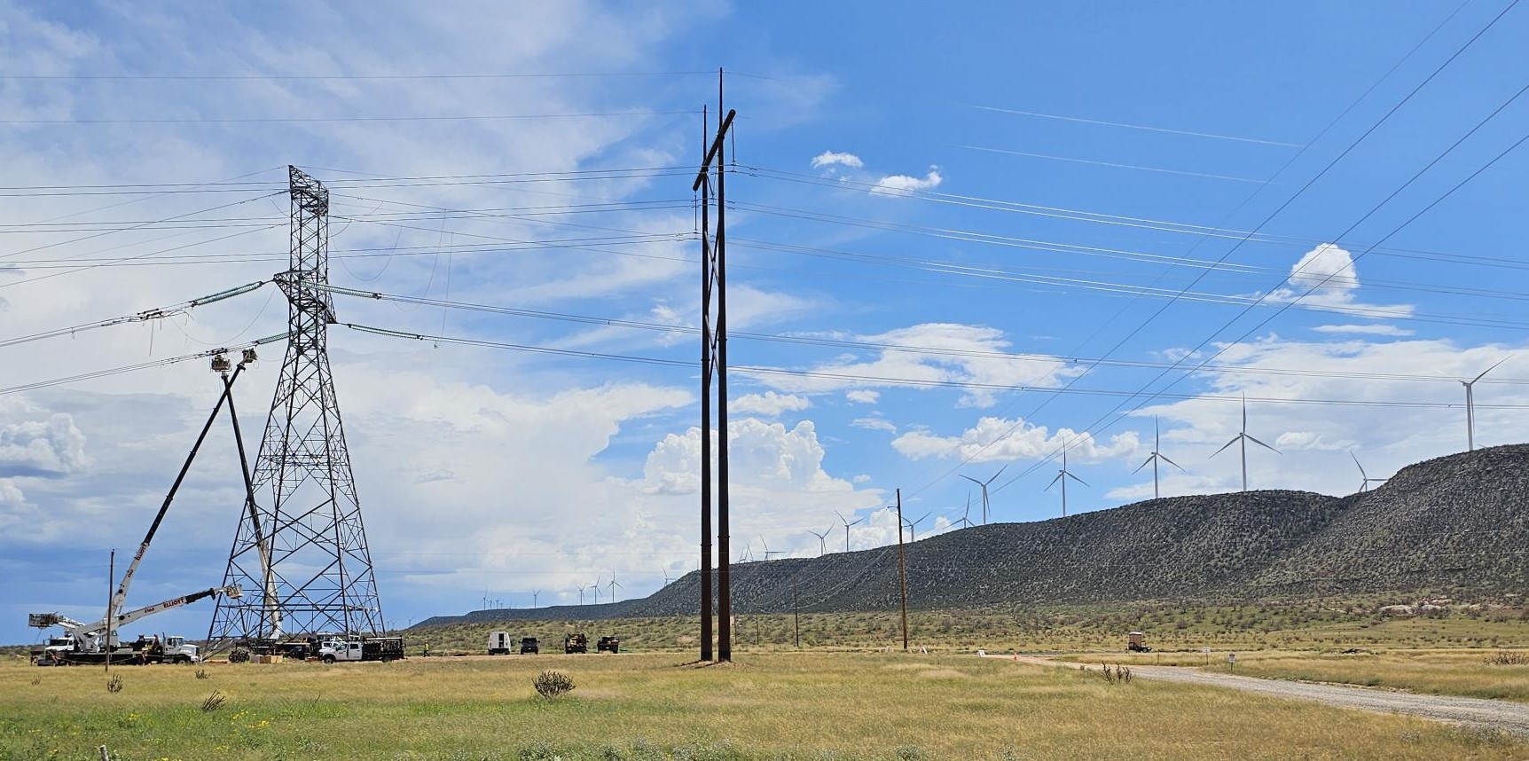
New Mexico Renewable Energy Transmission Authority
505-699-0599
www.nmreta.com
Thank you
5

